Slide 1
CRTM WebApp
Juan Antonio Celaya Rodríguez
David Roldán Alvarez
David Martinez Diaz
Zakaria Smaty Smaty

Slide 2
Objective
Our main objective is to create a final application that shows the bus stops, routes and times on a Madrid map based on the dataset that we have selected, using the information provided.
A user testing the application should be able to:
Find nearby stops by clicking on any point of the map (1 km circle range)
Check arrival time of the buses in any stop available on the map
Draw any bus route on the map by giving the bus number

Slide 3

Dataset
Our selected dataset contains information about bus routes, stops, times and timetables.
The dataset fulfill the 6 requirements of the statement.
The dataset is published under the CRTM Open and Static Data License.
This license allows free reuse provided that the following conditions are met:
Mandatory attribution: Powered by Consorcio Regional de Transportes de Madrid (CRTM).
Preservation of metadata and provenance information.
No implication of sponsorship or endorsement by the CRTM.
Csv Files
Routes.csv, Trips.csv
Stops.csv, Stop-times.csv
Agency.csv, Calendar.csv

Slide 4

Data Processing
Using OpenRefine we modified 6 of our CSVs ( routes, stops, stop-times, trips, agency and calendar)
Most of the changes were dataType changes, useless blankspace removal, handling empty/null values correctly and removal of duplicate rows.
In Stops, Routes y Trips, we used a GREL script on all address columns to normalize the naming by uppercasing, providing accents where absent and completing all abbreviations, e.g.:
AVDA -> AVENIDA
S.L.ESCORIAL -> SAN LORENZO DEL ESCORIAL
ALCALDE J.MªDE LAS HERAS-CHINCHÓN -> ALCALDE JOSÉ MARÍA DE LAS HERAS-CHINCHÓN
Removal of empty columns

Slide 5
Ontology
Our ontology models the GTFS standard to represent the CRTM bus network.
Nodes: Agency, BusRoute, Trip, Stop, StopTime, CalendarService and Shape
We deleted the nodes: FeedInfo and CalendarException
Reused other ontologies such as:
Schema.org
WGS84 Geo Positioning
W3C Time Ontology

Slide 6



RDF Generation
We used YARRRML to build our mappings
Used Matey to get an RML file.
Tried to use Morph to get the final Turtle file but we had too many problems.
Finally used RMLio

Slide 7
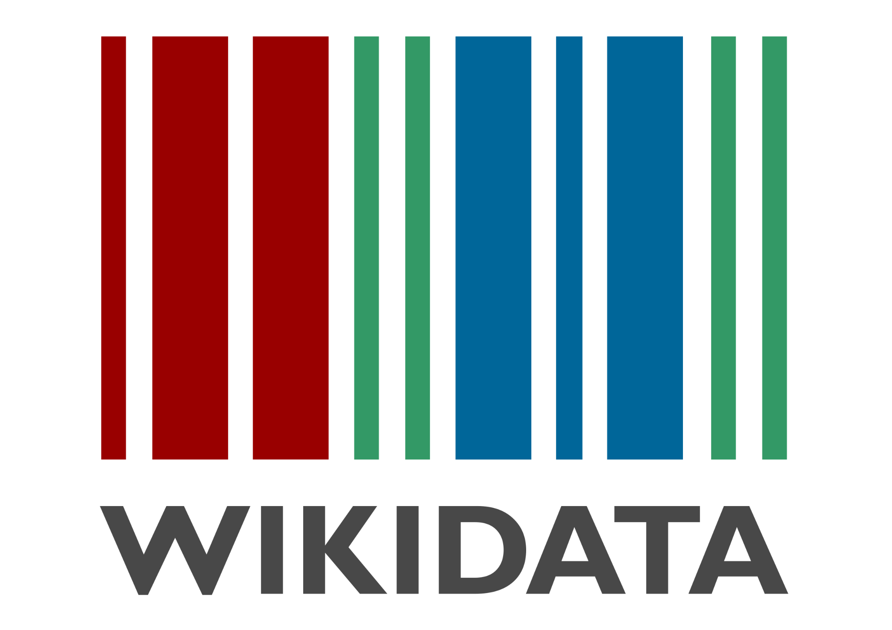

Data Linking
Our data was linked to Wikidata using the OpenRefine tool
We selected the street names as the main category for linking
Process:
We matched the street names of our bus stops
We reconciled them against Wikidata filtering by "street" type to ensure accuracy.
We extracted the official Wikidata URI, creating an owl:sameAs link

Slide 8
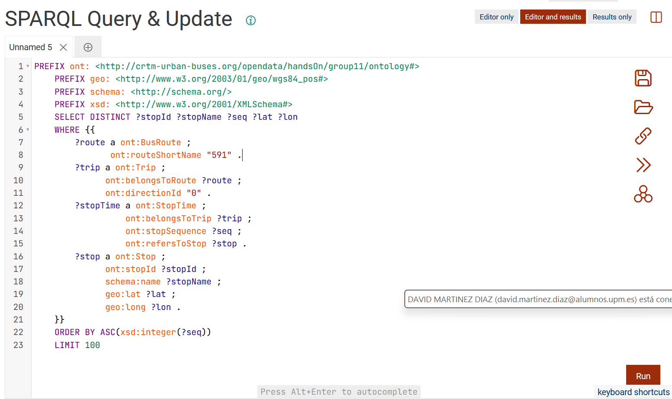
Linked Data Publishing
We used GraphDB to create a virtual server.
This allowed us to:
-Upload and store our ontology.
-Consult, using a SPARQL query, the information.

Slide 9
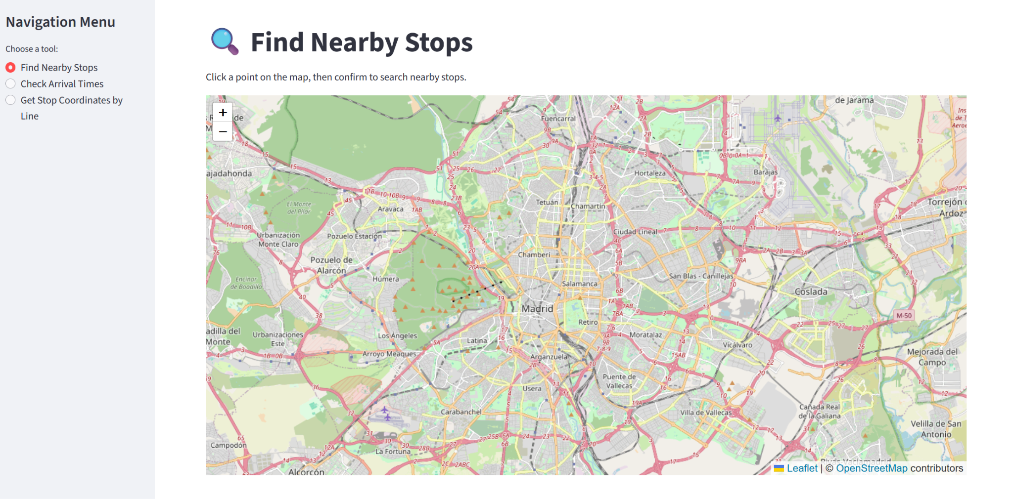
App
We connected our app with our repository in GraphDB through SPARQLWrapper.
We use the python's library Streamlit to create an interactive web application which allows the user to search specific information about buses.

